Slide 1
Intelligent Agents

Slide 2
Agents
An agent is anything that can be viewed as perceiving its environment through sensors and acting upon that environment through actuators
Human agent:
eyes, ears, and other organs for sensors;
hands, legs, mouth, and other body parts for
actuators
Robotic agent:
cameras and infrared range finders for sensors; various motors for actuators

Slide 3
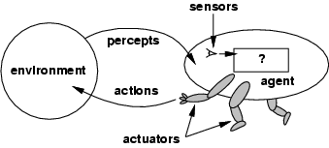
Agents and environments
The agent function maps from percept histories to actions:
[f: P* → A]
The agent program runs on the physical architecture to produce f
agent = architecture + program

Slide 4

Vacuum-cleaner world
Percepts: location and state of the environment, e.g., [A,Dirty], [B,Clean]
Actions: Left, Right, Suck, NoOp

Slide 5
Rational agents
Rational Agent: For each possible percept sequence, a rational agent should select an action that is expected to maximize its performance measure, based on the evidence provided by the percept sequence and whatever built-in knowledge the agent has.
Performance measure: An objective criterion for success of an agent's behavior
E.g., performance measure of a vacuum-cleaner agent could be amount of dirt cleaned up, amount of time taken, amount of electricity consumed, amount of noise generated, etc.

Slide 6
Rational agents
Rationality is distinct from omniscience (all-knowing with infinite knowledge)
Agents can perform actions in order to modify future percepts so as to obtain useful information (information gathering, exploration)
An agent is autonomous if its behavior is determined by its own percepts & experience (with ability to learn and adapt)
without depending solely on build-in knowledge

Slide 7
Task Environment
Before we design an intelligent agent, we must specify its “task environment”:
PEAS:
Performance measure
Environment
Actuators
Sensors

Slide 8
PEAS
Example: Agent = taxi driver
  Performance measure: Safe, fast, legal, comfortable trip, maximize profits
  Environment: Roads, other traffic, pedestrians, customers
  Actuators: Steering wheel, accelerator, brake, signal, horn
  Sensors: Cameras, sonar, speedometer, GPS, odometer, engine sensors, keyboard

Slide 9
PEAS
Example: Agent = Medical diagnosis system
Performance measure: Healthy patient, minimize costs, lawsuits
Environment: Patient, hospital, staff
Actuators: Screen display (questions, tests, diagnoses, treatments, referrals)
Sensors: Keyboard (entry of symptoms, findings, patient's answers)

Slide 10
PEAS
Example: Agent = Part-picking robot
Performance measure: Percentage of parts in correct bins
Environment: Conveyor belt with parts, bins
Actuators: Jointed arm and hand
Sensors: Camera, joint angle sensors

Slide 11
Environment: Observability
In terms of observability, an environment can be characterized as fully observable or partially observable.
In a fully observable environment all of the environment relevant to the action being considered is observable.
In such environments, the agent does not need to keep track of the changes in the environment.
A chess playing system is an example of a system that operates in a fully observable environment.

Slide 12
Environment: Observability
In a partially observable environment, the relevant features of the environment are only partially observable.
A POKER game is an example of a system operating in a partially observable environment.

Slide 13
Environment: Determinism
In deterministic environments, the next state of the environment is completely described by the current state and the agent’s action.
Image analysis systems are examples of this kind of situation.
The processed image is determined completely by the current image and the processing operations.

Slide 14
Environment: Determinism
Stochastic: If an element of interference or uncertainty occurs then the environment is stochastic.
Note that a deterministic yet partially observable environment will appear to be stochastic to the agent. E.g. Ludo Game
Strategic: If the environment state is wholly determined by the preceding state and the actions of multiple agents, then the environment is said to be strategic. Example: Chess.

Slide 15
Environment: Episodicity
Episodic/Sequential
An episodic environment means that subsequent episodes do not depend on what actions occurred in previous episodes.
In a sequential environment, the agent engages in a series of connected episodes.
For example, an agent that has to spot defective parts on an assembly line bases each decision on the current part, regardless of previous decisions.
Chess and taxi driving arc sequential: in both cases, short-term actions
can have long-term consequences.

Slide 16
Environment: Dynamism
Static Environment: does not change from one state to the next while the agent is considering its course of action. The only changes to the environment are those caused by the agent itself.
A Dynamic Environment changes over time independent of the actions of the agent
Taxi driving is clearly dynamic: the other cars and the taxi itself keep moving while the driving algorithm dithers about what to do next.
Crossword puzzles are static

Slide 17
Environment: Continuity
If the number of distinct percepts and actions is limited, the environment is discrete, otherwise it is continuous.
For example, the chess environment has a finite number of distinct states (excluding the clock).
Chess also has a discrete set of percepts and actions.
Taxi driving is a continuous-state and continuous-time problem: the speed and location of the taxi and of the other vehicles sweep through a range of continuous values and do so smoothly over time. Taxi-driving actions are also continuous (steering angles, etc.).

Slide 18
Environment: Presence of Other agents
A multi-agent environment has other agents. If the environment contains other intelligent agents, the agent needs to be concerned about strategic, game-theoretic aspects of the environment (for either cooperative or competitive agents).

Slide 19
Environment types
Fully observable (vs. partially observable): An agent's sensors give it access to the complete state of the environment at each point in time.
Deterministic (vs. stochastic): The next state of the environment is completely determined by the current state and the action executed by the agent. (If the environment is deterministic except for the actions of other agents, then the environment is strategic)
Episodic (vs. sequential): An agent’s action is divided into atomic episodes. Decisions do not depend on previous decisions/actions.

Slide 20
Environment types
Static (vs. dynamic): The environment is unchanged while an agent is deliberating. (The environment is semidynamic if the environment itself does not change with the passage of time but the agent's performance score does)
Discrete (vs. continuous): A limited number of distinct, clearly defined percepts and actions.
How do we represent or abstract or model the world?
Single agent (vs. multi-agent): An agent operating by itself in an environment. Does the other agent interfere with my performance measure?

Slide 21
task environm. | observable | determ./ stochastic | episodic/ sequential | static/ dynamic | discrete/ continuous | agents
crossword puzzle | fully | determ. | sequential | static | discrete | single
chess with clock | fully | strategic | sequential | semi | discrete | multi
poker
back gammon
taxi driving | partial | stochastic | sequential | dynamic | continuous | multi
medical diagnosis | partial | stochastic | sequential | dynamic | continuous | single
image analysis | fully | determ. | episodic | semi | continuous | single
partpicking robot | partial | stochastic | episodic | dynamic | continuous | single
refinery controller | partial | stochastic | sequential | dynamic | continuous | single
interact. Eng. tutor | partial | stochastic | sequential | dynamic | discrete | multi

Slide 22
task environm. | observable | determ./ stochastic | episodic/ sequential | static/ dynamic | discrete/ continuous | agents
crossword puzzle | fully | determ. | sequential | static | discrete | single
chess with clock | fully | strategic | sequential | semi | discrete | multi
poker | partial | stochastic | sequential | static | discrete | multi
back gammon | fully | stochastic | sequential | static | discrete | multi
taxi driving | partial | stochastic | sequential | dynamic | continuous | multi
medical diagnosis | partial | stochastic | sequential | dynamic | continuous | single
image analysis | fully | determ. | episodic | semi | continuous | single
partpicking robot | partial | stochastic | episodic | dynamic | continuous | single
refinery controller | partial | stochastic | sequential | dynamic | continuous | single
interact. Eng. tutor | partial | stochastic | sequential | dynamic | discrete | multi

Slide 23
Agent types
Five basic types in order of increasing generality:
Table Driven agents
Simple reflex agents
Model-based reflex agents
Goal-based agents
Utility-based agents

Slide 24
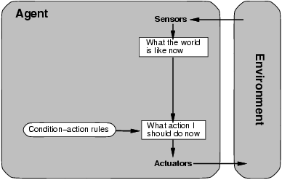
Table Driven Agent.
current state of decision process
Impractical
table lookup
for entire history

Slide 25
Simple reflex agents
Fast but too simple
NO MEMORY
Fails if environment
is partially observable
example: vacuum cleaner world
Notes:
-Act only on the basis of current percept
Ignore the rest of the percept history
Based on IF-Then rules
Env should be fully observable

Slide 26
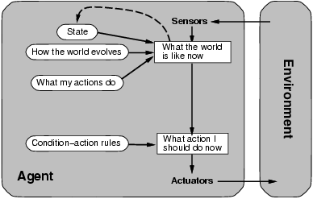
Model-based reflex agents
description of
current world state
Model the state of the world by:
modeling how the world chances
how it’s actions change the world
This can work even with partial information
It’s is unclear what to do
without a clear goal

Slide 27
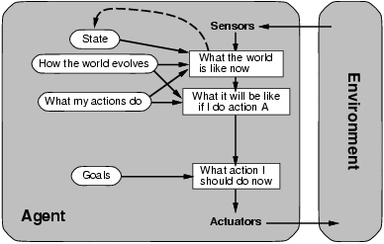
Goal-based agents
Goals provide reason to prefer one action over the other.
We need to predict the future: we need to plan & search
Notes:
Extension of model based reflex agent.
For example, your goal is to visit Muree (Goal). You need to perform searching and planning.

Slide 28
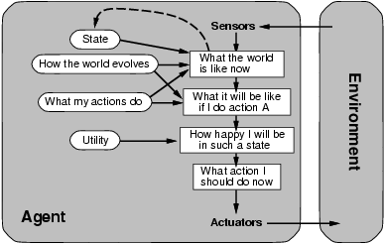
Utility-based agents
Some solutions to goal states are better than others.
Which one is best is given by a utility function.
Which combination of goals is preferred?
Notes:
Focus on utility not goal
Deals with the happy and un happy state
Utility based agent act based not only goals but also the best way to achieve the goal
Utility based agent is useful when there are multiple possible alternatives, and an agent has to choose in order to perform best action
The utility function maps each state to a real number to check how efficiently each action achieves the goals.
Recommendation systems
Trading Robots: These robots use utility functions to evaluate investment options and trading decisions based on maximizing their ROI

Slide 29
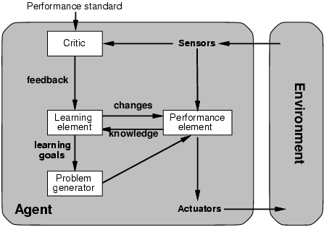
Learning agents
How does an agent improve over time?
By monitoring it’s performance and suggesting
better modeling, new action rules, etc.
Evaluates
current
world
state
changes
action
rules
“old agent”=
model world
and decide on
actions
to be taken
suggests
explorations
Notes:
Learning agents can improve their performance by learning from experiences
Unlike other agents, they can adopt to new or unknown environment
Learning elements -> Helps the agent improve, Performance element -> Make the decision , Critic -> Provide feedback , Problem generator -> New actions to explore

Slide 30
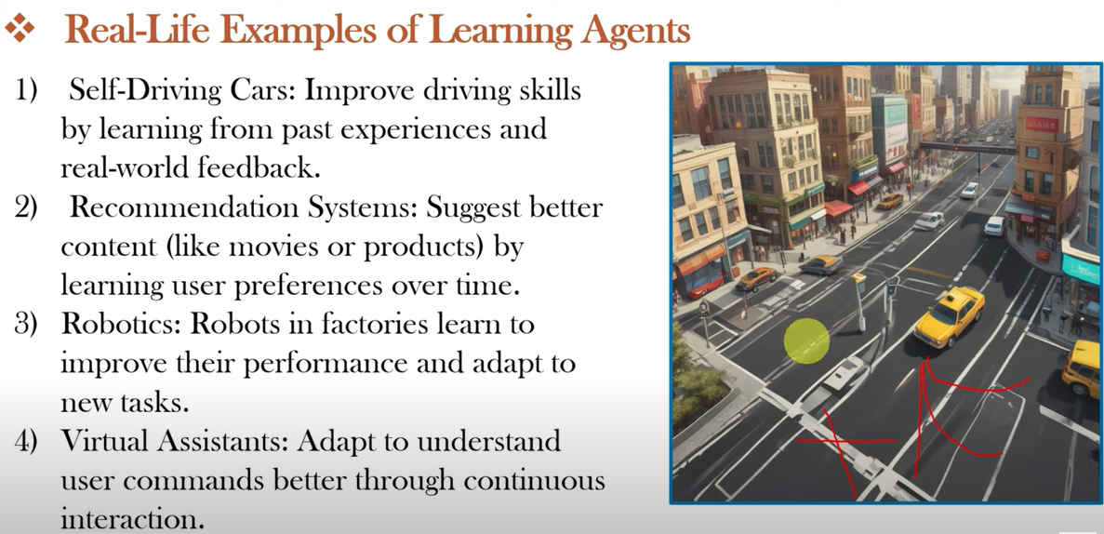

Slide 31
Self driving car Examp
Consider the self-driving car for all the five type of an agents
If there is a roadblock ahead then for simple reflex agent it will simply change the route, it will not think that some cars are nearby.
Model based reflex agent: has memory of other cars which is coming behind so it will change the route accordingly. If the car is very near in the parallel lane, it will slow down, allow the other cars to pass and then change the lane.
Goal base agent: It will slow down allow other cars to pass and then change the route in such a way that the next route direction is closer to its goal.
Utility based agent: If there are three different paths to reach the distination, it will choose the shortest path.
Learning Agent: It will first learn which out of the three routes is the best route in every trip it passes on the route. For example, one route may be shortest, but it usually faces traffic jams.

